Slide 1
Physiological changes in pregnancy
Dr.Carmeline motha
MBBS(Col),MD,MRCP(UK)
Consultant physician and senior lecturer,
Department of obstetrics & gynaecology,
Faculty of medicine, Ragama

Slide 2
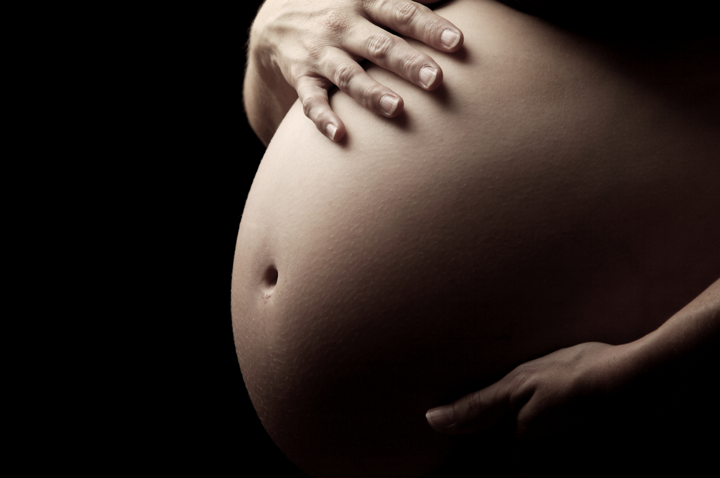

Slide 3
Cardiovascular system

Slide 4
Cardiovascular system
The major hemodynamic changes induced by pregnancy include,
sodium and water retention leading to blood volume expansion
an increase in cardiac output
reduction in systemic vascular resistance
reduction in systemic blood pressure

Slide 5
Plasma volume
Expansion of the plasma volume
begin as early as the fourth week of pregnancy
peak at 28 to 34 weeks of gestation and then plateau until parturition
30- 50% increase by 34 weeks

Slide 6
Cardiac output
The cardiac output rises by 30-50% above baseline during normal pregnancy; Maximal around 20-28 weeks gestation.
CO = HR × SV
Preload is increased due to the associated rise in blood volume
Afterload is reduced due to the decline in systemic vascular resistance
Maternal heart rate rises by 15 to 20 beats/min; Maximal around 28-34 wks; this compensates for the declining stroke volume towards term
In early pregnancy – increase in SV
Late pregnancy- Increase in HR

Slide 7
Cardiac output
CO increase by 15% above pre labour levels in early labour and 25 % during the active phase
The additional exertion associated with pushing in the second stage results in a 50% rise in cardiac output
Immediately postpartum, cardiac output increases to 80%

Slide 8
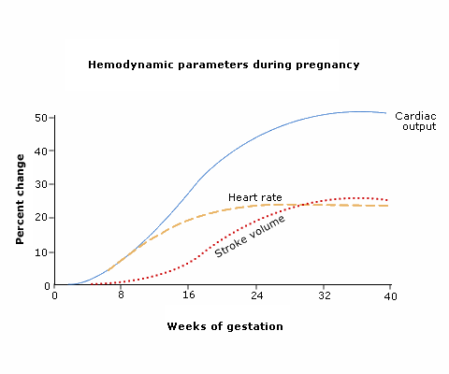

Slide 9
Systemic vascular resistance
Decreased vascular responsiveness to the pressor effects of angiotensin II and norepinephrine
Increased concentration of nitric oxide in the circulation

Slide 10
Blood pressure
BP = CO × SVR
Fall in SVR is manifest by a fall in blood pressure, which begins by the end of the first trimester and lowest at 22-24 weeks
Systolic and diastolic blood pressure fall and are about 5 to 10 mmHg below baseline in the second trimester, declining to a mean of about 105/60 mmHg
In the third trimester, blood pressure gradually increases and may normalize to non pregnant values by term

Slide 11
Pulmonary artery pressure
Pulmonary artery pressure remains unchanged; The increase in pulmonary blood flow is balanced by a decrease in pulmonary vascular resistance.
CVP remains unchanged

Slide 12
Anatomical changes in CVS
The heart is shifted to the left, anterior, and rotated toward a transverse position as the uterus enlarges.
The apical impulse is shifted cephalad to the fourth intercostal space and laterally to the midclavicular line.

Slide 13
Precordial examination
A third heart sound is present in most
wide splitting of S1
A ejection systolic murmur (upto grade 2/4) in the pulmonary and tricuspid area is found in the majority
The mammary souffle (systolic or continuous) is heard over the breasts in late gestation; it is especially common postpartum in lactating women

Slide 14

Cardiac physiology
Left atrial enlargement leads to stretching of the cardiac conduction pathways and predisposes to alterations in cardiac rhythm.
Periods of supraventricular tachycardia and ventricular extrasystoles are a common finding.
Normal ECG findings
Transient ST segment and T wave changes in lateral leads
Q wave and inverted T waves in lead III
Q wave in lead AVF
Inverted T waves in leads V1, V2 and occasionally V3

Slide 15
Endocrine system

Slide 16
Human chorionic gonadotrophin(HCG)
Syncytiotrophoblast secretes HCG
Appears by 8-9 d after ovulation; Maximum levels at 10-12 wks; low levels by 16-20wks
Glycoprotein similar to LH, FSH and TSH
Prevents involution of corpus luteum at the end of the monthly menstrual cycle maintaining the decidual nature of the endometrium

Slide 17
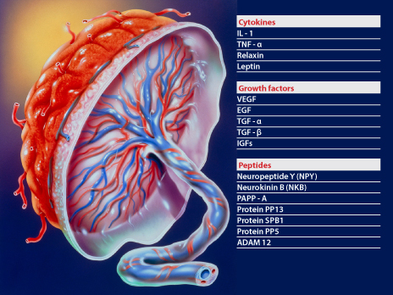
Placental hormones

Slide 18
Placental endocrine functions
Oestrogen
Secreted by CL and placenta
Progesterone
Secreted by CL and placenta

Slide 19
Human placental lactogen (HPL)
Human chorionic somatomammotropin
Lactogenic
Secreted by placenta around 5th wk
Peaks around 30 weeks
Increases progressively throughout gestation
Effects:
-↓ maternal insulin sensitivity leading to an increase in maternal blood glucose levels.
-↓ maternal glucose utilization, which helps ensure adequate fetal nutrition
-↑ lipolysis with the release of free fatty acids
Structure and function similar to GH

Slide 20
GnRH
There is a decline in circulating gonadotrophin concentrations across gestation with a progressively diminishing response to GnRH
Inhibitory effect of oestrogen and progesterone
Effect of the high maternal serum levels of inhibin A and inhibin B produced by placenta and fetal membranes

Slide 21
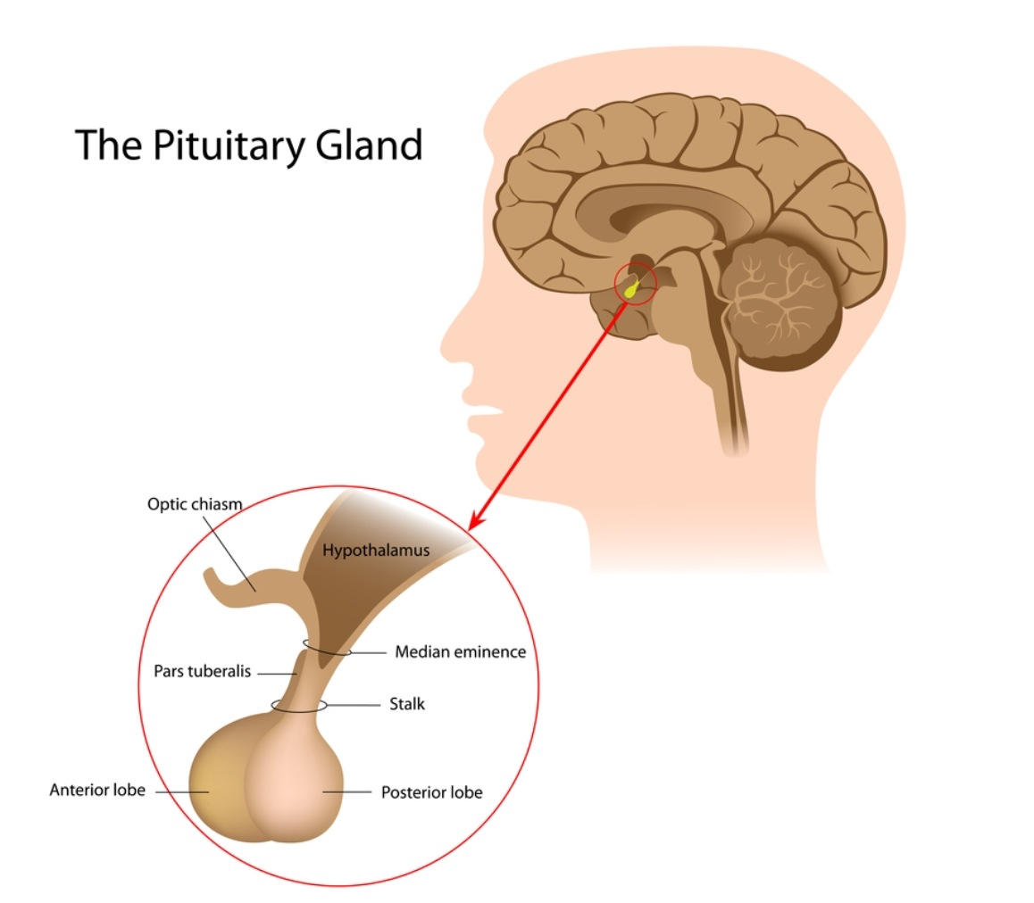
Pitiutary gland
The anterior lobe of the pituitary gland enlarges up to threefold during gestation because of hyperplasia and hypertrophy.
Proliferation of prolactin producing cells
Pituitary growth hormone production is reduced; Placental growth hormone production is increased.
Net increase in serum growth hormone levels

Slide 22
Pitiutary hormones
Increase in serum ACTH concentrations probably in response to CRH produced by trophoblasts
Its concentration in maternal circulation is high and rises exponentially throughout pregnancy
The serum prolactin concentration increases throughout pregnancy, reaching a peak at delivery (10 fold) to prepare the breast for lactation.
Oxytocin involved in the process of parturition and the "let down" response during lactation rise continuously across gestation

Slide 23
Cortisol
Increase in cortisol
Total cortisol increase by the end of the first trimester and are 3 times higher than the non pregnant values by the end of pregnancy
Increase in ACTH and CRH (produced by the placenta)
Diurnal variations in ACTH and cortisol are maintained

Slide 24
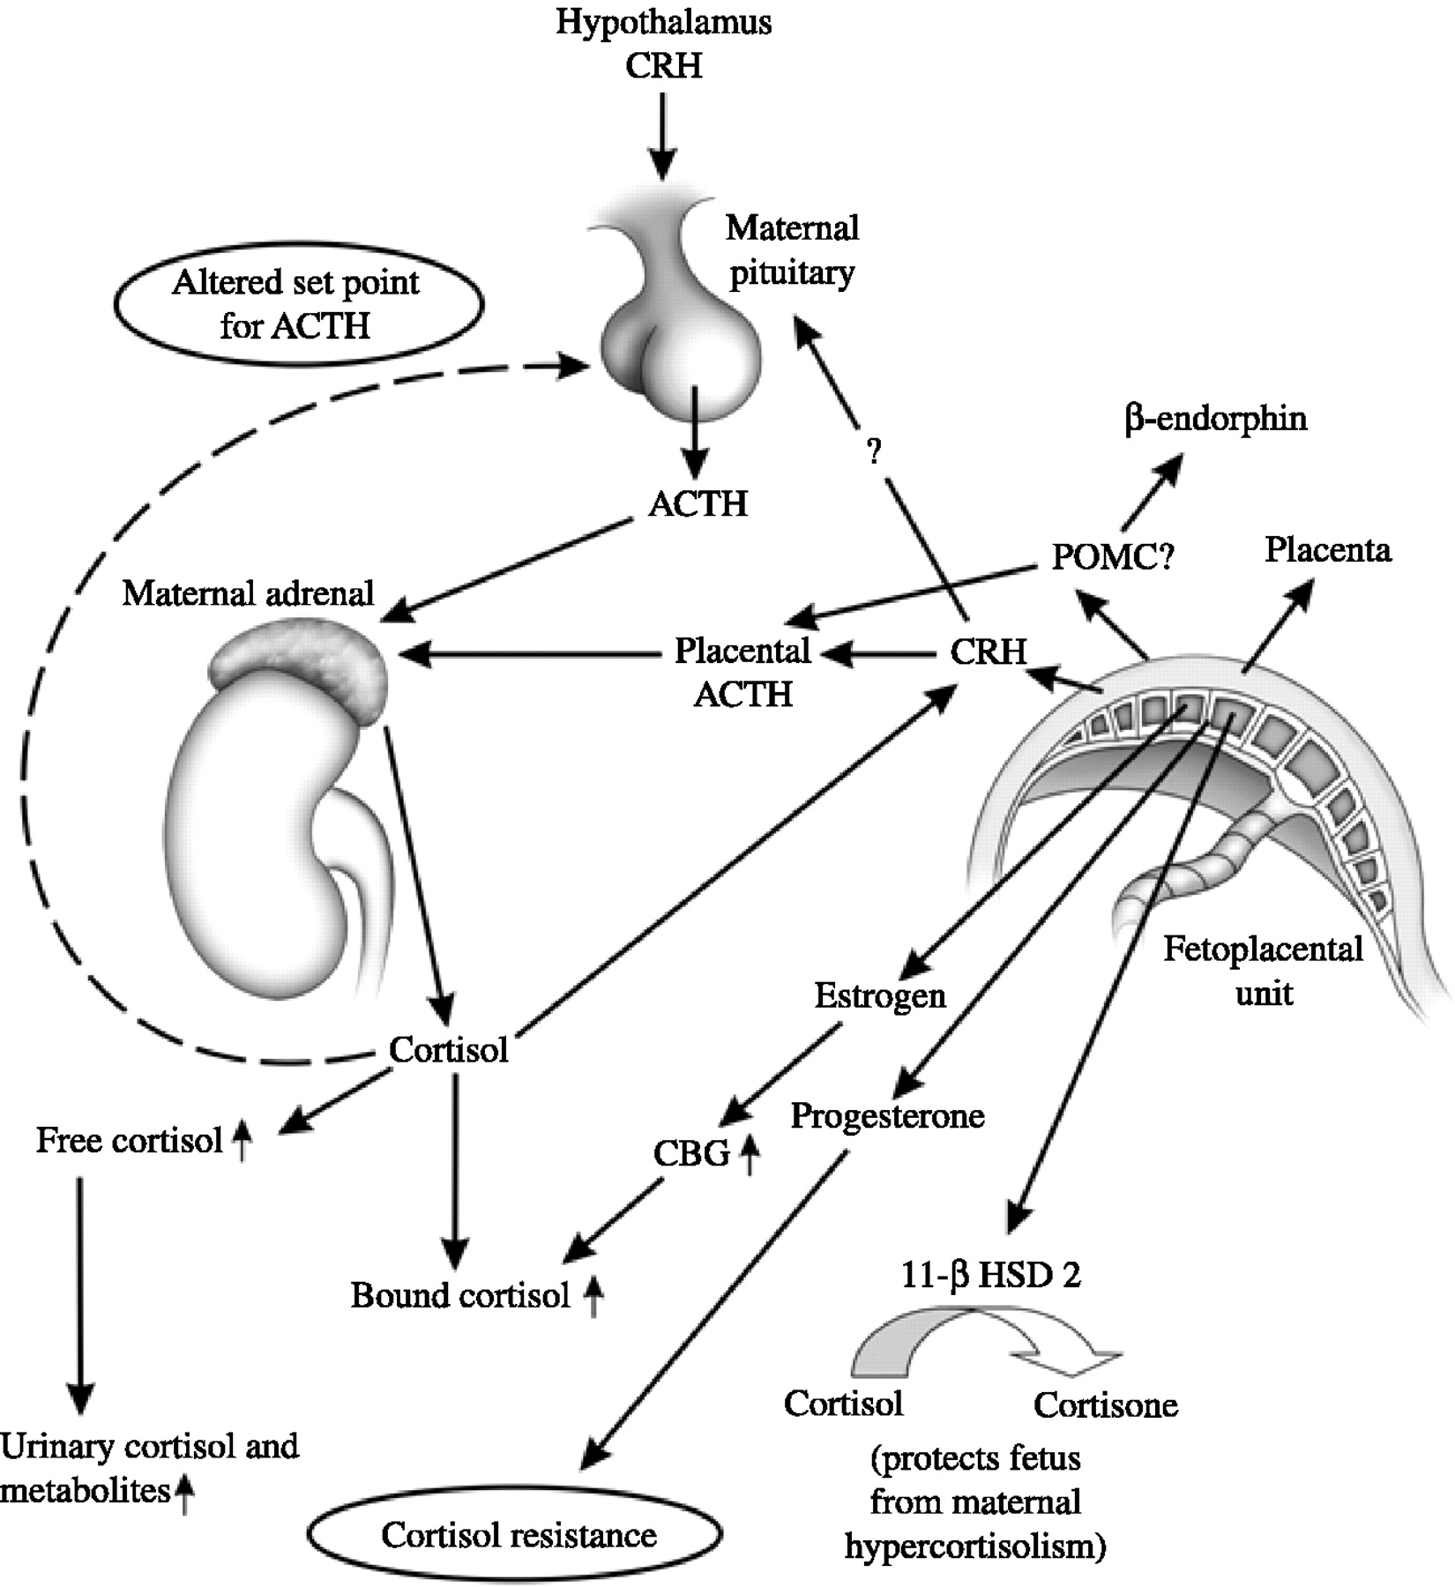

Slide 25
Thyroid physiology
Increased production of thyroxine binding globulin from the liver
Total T4 and T3 are increased
Free fraction remains unaltered
Iodine deficiency
Transfer across the placenta
Increased excretion in the urine
WHO recommendation – Iodine intake 150-200 mg/day

Slide 26
Normal reference range for thyroid hormones in pregnancy
Trimester | SerumTSH (µIU/mL) | FT4 (pg/ml)
First | 0.1-2.5 | 0.83-1.27
Second | 0.2-3.0 | 0.71-1.05
third | 0.3-3.0 | 0.72-1.06

Slide 27
The Renin Angiotensin Aldosterone system
The renin-angiotensin-aldosterone system is stimulated during pregnancy because of the associated reductions in vascular resistance and blood pressure
A striking increase in aldosterone levels is observed by the eighth week of pregnancy and continues to rise

Slide 28
Glucose metabolism
Hyperplasia of pancreatic beta cells, increased insulin secretion, and an early increase in insulin sensitivity followed by progressive insulin resistance
Insulin resistance begins in the second trimester and peaks in the third trimester (doubling of insulin from the end of 1st trimester – end of third trimester)
It results from increased placental secretion of diabetogenic hormones including growth hormone, cortisol, HPL, prolactin and progesterone

Slide 29
Glucose metabolism
Insulin resistance and the relative hypoglycemia of pregnant women results in increased lipolysis, which allows the mother to:
Preferentially use free fatty acids, triglycerides, ketone bodies for fuel.
Preserve much of the available glucose and amino acids for the fetus.
Minimize protein catabolism.

Slide 30
Glucose metabolism in pregnancy
First half of pregnancy (Anabolic)
Pancreatic beta cell hyperplasia – hyperinsulinaemia
Increased uptake and storage of glucose
Second half of pregnancy (Catabolic)
Placental hormones block glucose receptors and cause insulin resistance
Increased lipolysis
Increased gluconeogenesis
Decreased glycogenesis

Slide 31

Osmoregulation
Systemic arterial vasodilatation
stimulates vasopressin release and upregulation of AQP2
Stimulates thirst
Plasma osmolality declines below the osmotic thirst threshold, and a new steady state is achieved
There is a decrease in the osmotic thresholds for thirst and arginine vasopressin (AVP) release
Plasma osmolality falls early in gestation to around 280 mOsm/Kg
Total body water increases by 6–8 L, most of which is extracellular

Slide 32
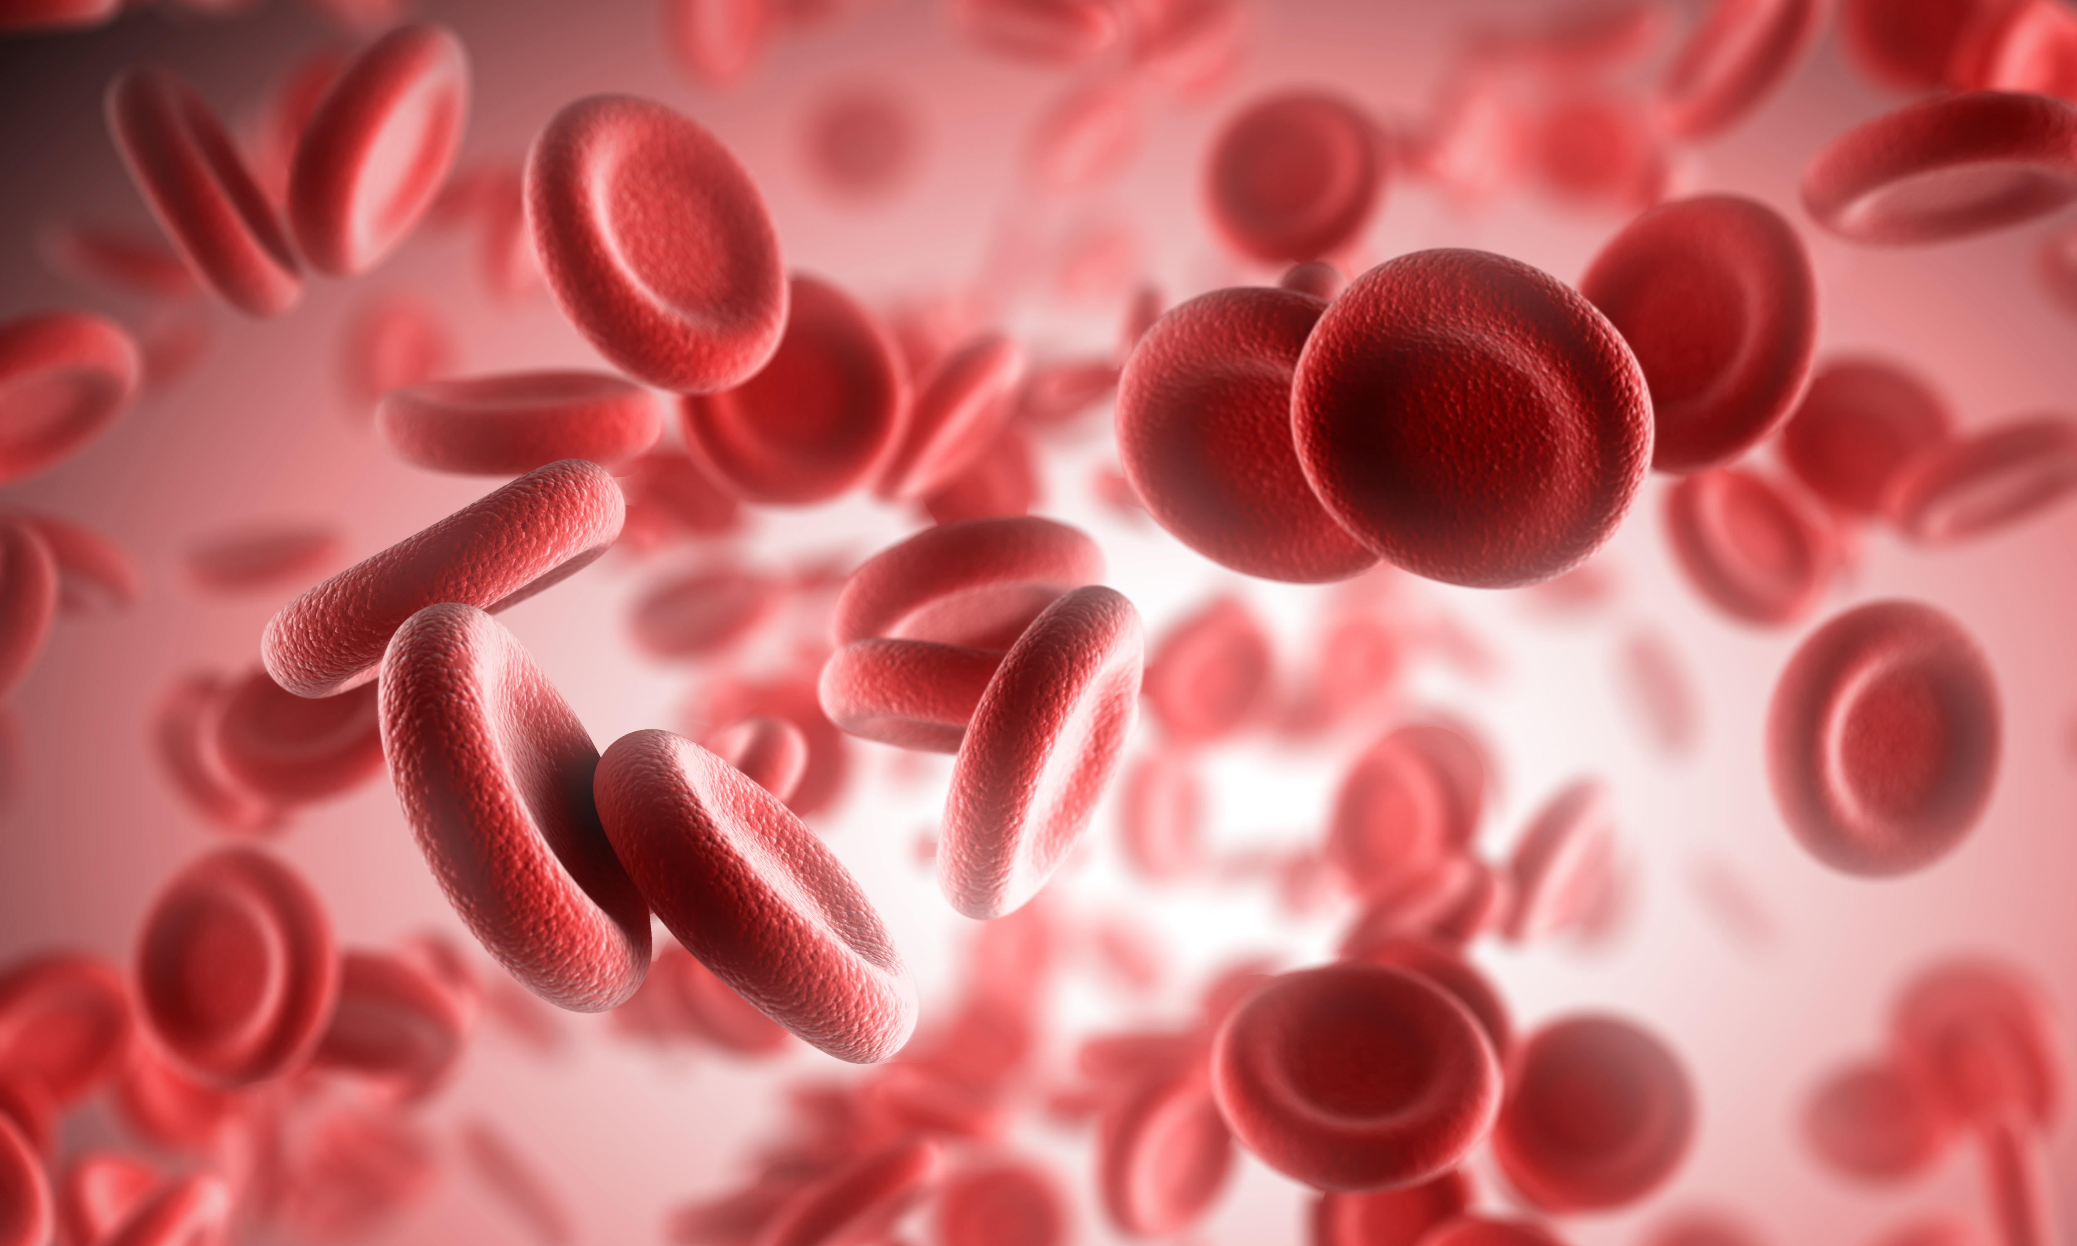
Haematology
Red Blood Cells
3 fold rise in erythropoietin; 50% rise
Physiological haemodilution maximal at 28-32 weeks.
White Blood Cells
WBC peaks at 30 weeks and plateau during the third trimester.
Further increase in labour and may rise to 40.0x109/L in uncomplicated pregnancy.
The count returns to non pregnant levels by 6 days postpartum

Slide 33
Haematology
Platelets
Fall progressively
5-10% mild thrombocytopaenia

Slide 34
Iron metabolism
The total requirement of iron = 700-1400 mg
The overall daily requirement = 4 mg
This can be achieved only by mobilising iron stores and maximum absorption of dietary iron.

Slide 35
Iron metabolism
WHO recommendation on iron supplementation:
30-60 mg per day to those with iron stores
120-240 mg per day to mothers with depleted iron stores

Slide 36
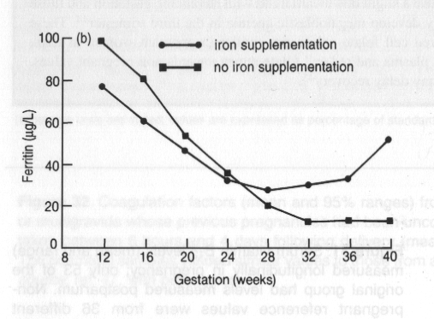

Slide 37
Haematology
Clotting factors- Physiological hypercoagulable stage
From T1- 12 weeks postpartum
Factors VII, VIII, IX, X, XII, Von Willebrand factor and plasma fibrinogen rise.(The latter by 50%)
Antithrombin and protein S decrease slightly.
Plasma fibrinolytic activity is reduced during pregnancy, remains low during labour and delivery, and returns to normal early after placental delivery.
Invitro APTT, PT and TT remain normal.
Increase in ESR four fold ( increase in globulin and fibrinogen)

Slide 38
DVT and pulmonary embolism
1/3rd of pregnancy related DVT occur postpartum
Most cases within 1st four weeks
Elective CS doubles the risk; further doubling with Em LSCS
Risk remains for 12 weeks postpartum
Mostly DVT of lower limbs
L > R – Due to compression of the left iliac vein by the L iliac artery and ovarian artery
½ of pregnancy related PE occur postpartum.
Half of antenatal VTE occur prior to 15 weeks

Slide 39
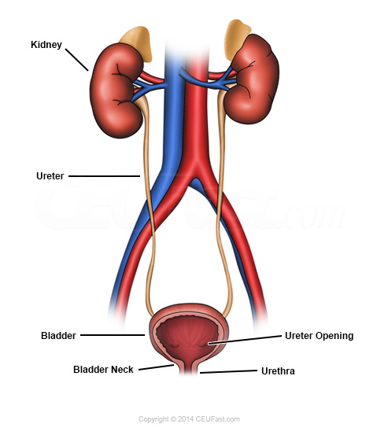
Renal
Renal size increases by 1-1.5 cm
Pelvicalyceal system dilatation-early as 6 weeks
Hydronephrosis occurs on the right in 90% of cases
Uterine enlargement may cause the ureters to become elongated, tortuous, and displaced laterally as pregnancy advances.
VU reflux
Bladder flaccidity
Decreased intraureteral pressure

Slide 40
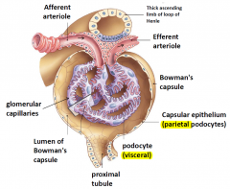
Glomerular function
Increase in GFR is observed within one month of conception and peaks at approximately 40-50% above baseline levels by the early second trimester and then declines slightly toward term
Fall in S. creatinine by an average of 0.4 mg/dL
300 mg/24 hr of urinary protein (protein creatinine ratio of 30mg/mmol) and 20 mg/24hr of albumin as the upper limit of normal in pregnancy
Increased natriuresis and Na reabsorption . Net increase in Na levels. Serum levels of Na decrease

Slide 42
Glomerular function
Reductions in reabsorption of glucose, amino acids, and beta microglobulin
Higher rates of urinary excretion with glycosuria and aminoaciduria in the absence of hyperglycemia or renal disease

Slide 43
Urinary frequency
Increases in the first trimester; mechanical compression of the bladder by the enlarged uterus is not likely to be the primary cause
Nocturia is common and increases with advancing gestation
Several studies have described an increase in urgency and urinary incontinence during pregnancy

Slide 44
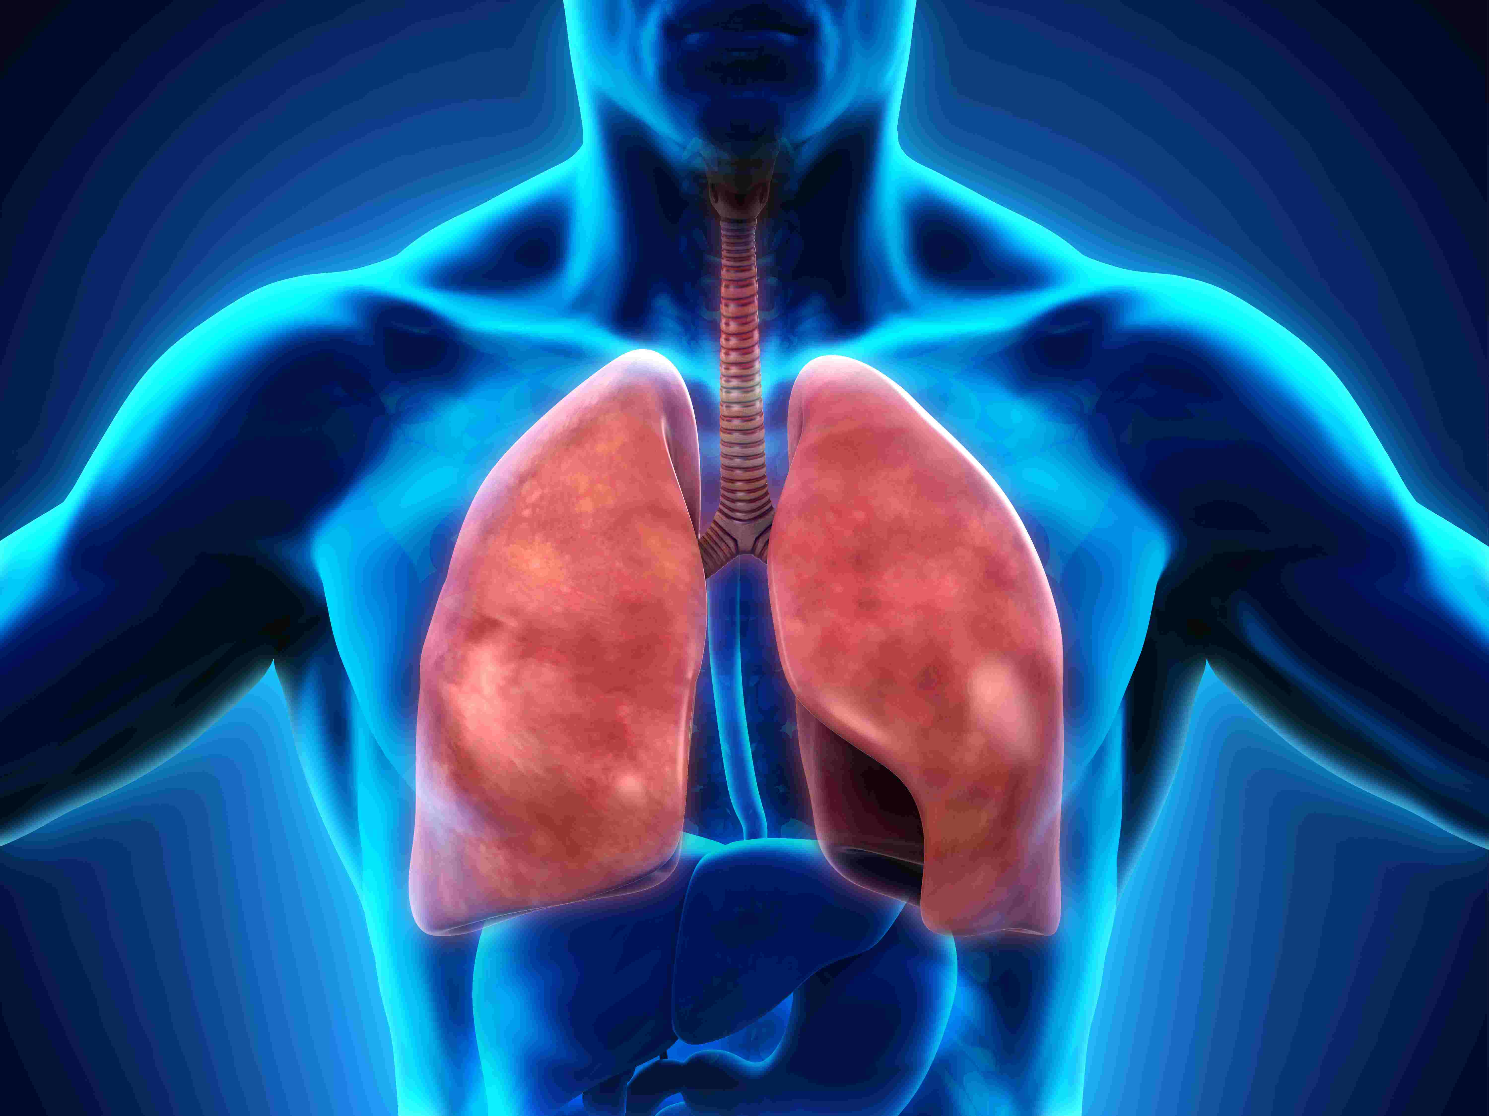
Respiratory system

Slide 45
Respiratory system
Thoracic cavity
Flaring out of lower ribs, increased transverse diam. and elevation of diaphragm.
Mainly diaphragmatic breathing
Respiratory function
Increased minute ventilation (30-50%) mainly by tidal volume rather than RR - Stimulated by progesterone; Tidal volume expands into the inspiratory and expiratory reserve volume.
Vital capacity and FEV1 unchanged
Increased maternal 2,3 DPG in RBC-shifts oxygen-Hb dissociation curve to the right

Slide 46
Respiratory system
Oxygen consumption increase by 20%
Rise in arterial oxygen levels from 100 to 110 mmHg.
Decrease in PaCo2 from 40 to 27-32 mmHg.
Respiratory alkalosis
pH is normal to slightly alkalotic (usually between 7.40 to 7.45)
Compensatory renal excretion of bicarbonate.

Slide 47
Reference ranges for respiratory function in pregnancy
Investigations | Pregnant | Non-pregnant
pH | 7.40–7.47 | 7.35–7.45
pCO₂, mmHg (kPa) | ≤ 30 (3.6–4.3) | 35–40 (4.7–6.0)
pO₂, mmHg (kPa) | 100–104 (12.6–14.0) | 90–100 (10.6–14.0)
Base excess | No change | +2 to –2
Bicarbonate (mmol/l) | 18–22 | 20–28

Slide 48
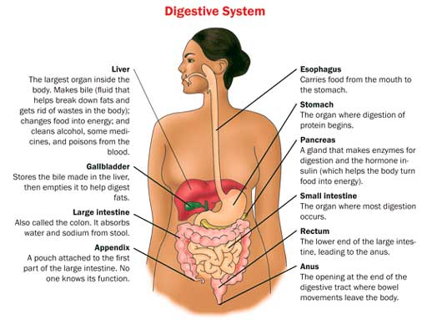
Gastrointestinal system
Increase in appetite
Spongy gums
Oesophageal reflux common
Gastric secretion and motility reduced
Doubling of stomach emptying time
Constipation
Slower emptying of gall bladder

Slide 49
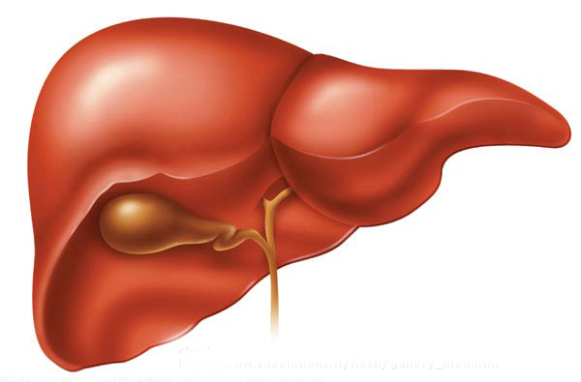

Slide 50
Cardiovascular adaptations in pregnancy include
Increase in CO to 40% of normal
An increase in blood volume proportional to the number of fetuses
An increase in HR of 50%
A maximum CO at 20-28 weeks of pregnancy
A 25% drop in CO on supine position in later stages of pregnancy

Slide 51
Regarding physiological changes in the cardiovascular system
Q waves and T inversion in lead 111 on ECG are normal findings
Maximum cardiac output occurs immediately following delivery
T inversion in lead 111 on ECG is considered normal
An increase in the pulmonary vascular resistance
A gradual rise in BP over the first 3-4 days following delivery

Slide 52
Human chorionic gonadotrophin
Shares a similar structure to LH
Can be detected at 8 days following ovulation
Causes a physiological thyrotoxicosis in pregnancy
Stimulates interstitial cells of the male fetus resulting in production of testosterone in male fetuses until birth.
CL involutes slowly after 13-17th week

Slide 53
Renal adaptations to pregnancy include,
An increase in GFR to 140-170ml/min
Increase glycosuria
Increase in proteinuria
Reduction of thirst threshold
Dilated pelvicalyceal system

Slide 54
Changes in the respiratory system in pregnancy include
An increase in minute ventilation
An increase in vital capacity
A reduction in FEV1
Respiratory alkalosis
A reduction of PaCO2

Slide 55
Metabolic changes in pregnancy include
Maternal weight gain distributed equally throughout pregnancy
Starvation leads to early ketosis that in non pregnant woman
FBS level is lower than in a non pregnant woman
Insulin levels are higher both in the fasting and postprandial states.
Insulin resistance increases progressively in pregnancy

Slide 56
Single best answer questions

Slide 57
Respiratory alkalosis in pregnancy is primarily due to
Increase in vital capacity
Increase in minute ventilation
Increase in transverse diameter of the thorax
Reduction in inspiratory reserve volume
Increase in respiratory rate

Slide 58
Accelerated starvation of pregnancy is due to
Increased lipolysis
Increased ketone production
Insulin resistance
Decreased protein catabolism
Low FBS in early pregnancy

Slide 59
The primary trigger for the increase in CO in pregnancy is
Increase in stroke volume
Reduction in systemic vascular resistance
Increased plasma volume
Increase in heart rate
Increased maternal cortisol levels

